Slide 1
MTH 353 Final Project
Mystery Object Recognition
Yuhan Wang

Slide 2
Overview
01
Data
02
Model
03
Conclusion
04
Brief introduction of the project
Data Collection & Data Processing
Model Training & Evaluation
Final Thoughts about the project

Slide 3
01
Project Overview
Build an Image Classification model to recognize images of artworks and predict its culture origin

Slide 4
Mystery Object Recognition
Machine Learning
Artwork Recognition
Art Historical Analysis
Build a Neural Network to classify artworks into different culture
Use the model to predict the culture of mystery objects
Guide art historical analysis between the mystery object & works from the culture

Slide 5
Approach
Data Exploration
Extract Insight
Data Processing
Preliminary Model
Model Training
Generate test dataset
Produce visualizations
Art Historical Analysis
Search for available images
Collect a small set as sample
Collect & process data
Check quantity & quality
Train 2 models
Adjust feature selections
Tune hyperparameters
Build preliminary models
Gather insights for data collection & processing
Notes:
Search for available images with clear culture references; Gather a small set of the image data as sample testing
Build preliminary models to test model’s tolerance of images; Gather insights for the data collection & processing

Slide 6
02
Data
750 Images from the collection of the Metropolitan Museum (MET)

Slide 7
Cultures Included & Data Distribution
Near East
Egyptian
Greek
Roman
150 images 300 images 250 images 50 images

Slide 8
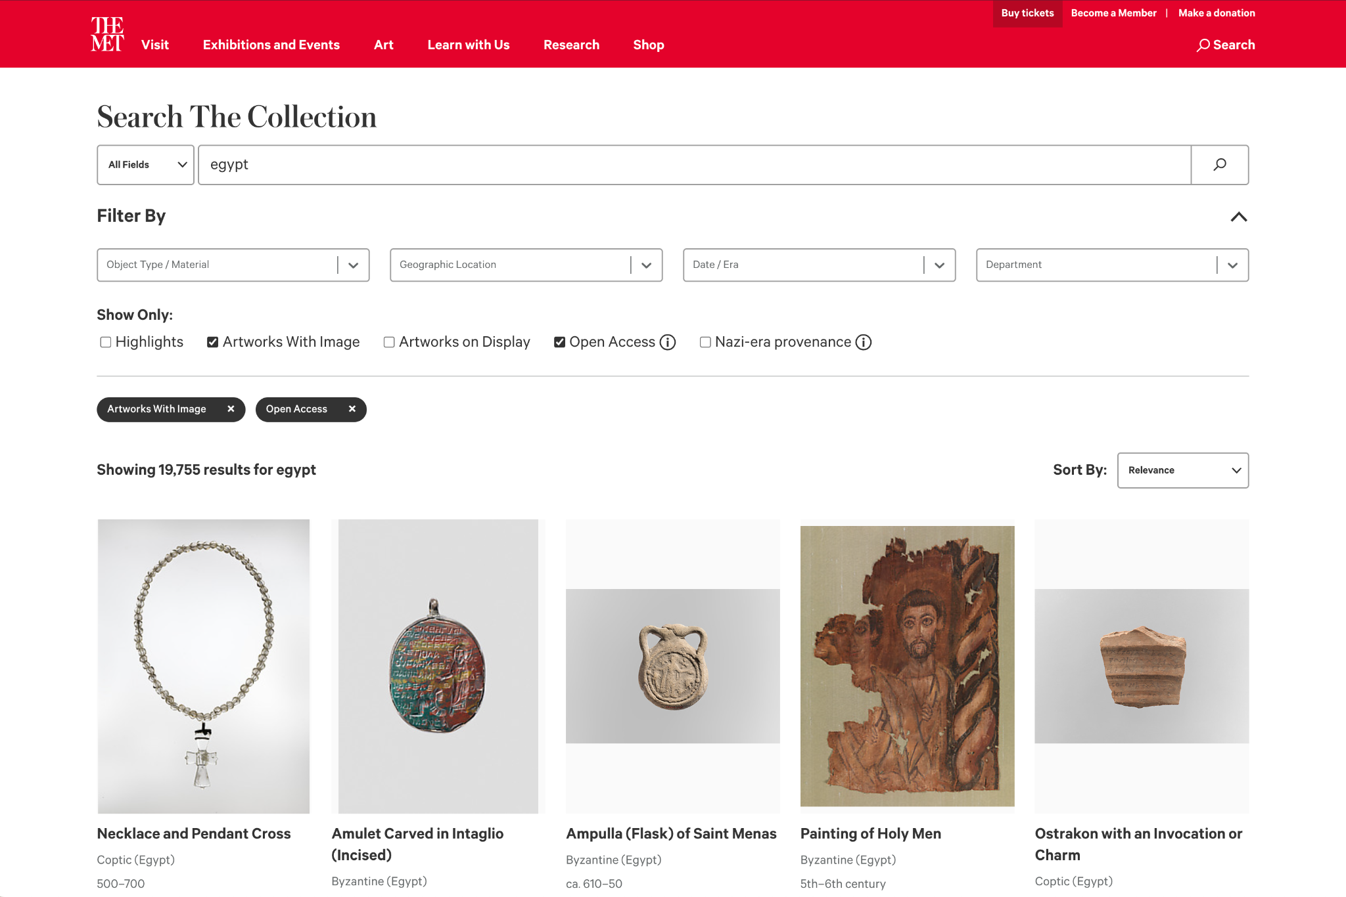
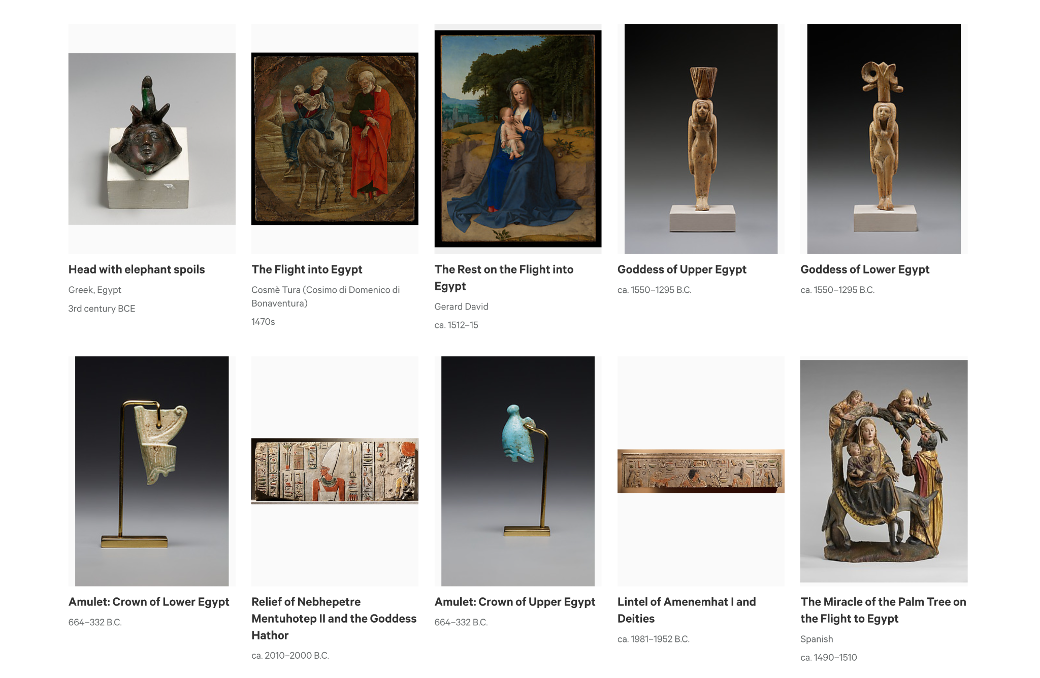
Data Explained
MET Collection
WikiArt + Google Search
Varied Resolution
Different formats
MET collection
High Resolution
Use the same collection to reduce noise factors
Culture & Distribution
Cultures covered in ARH 212
Availability of artworks of different cultures
e.g. Combine 12 cultures of similar period to “Near East”

Slide 9
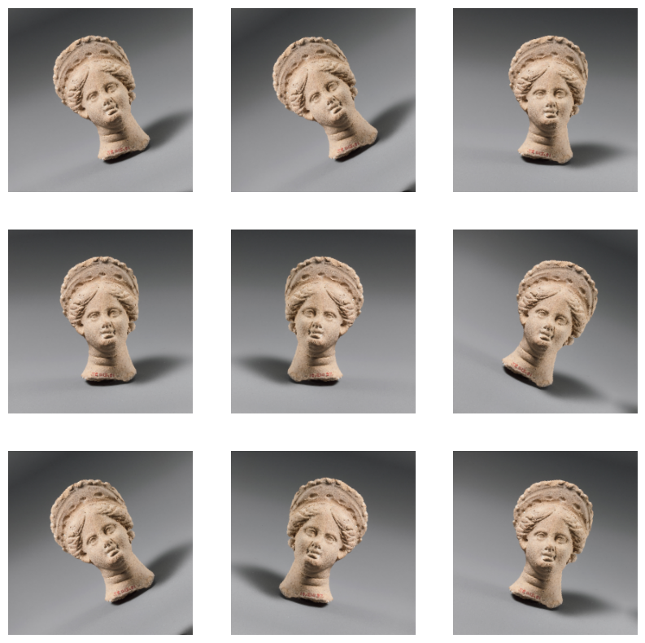
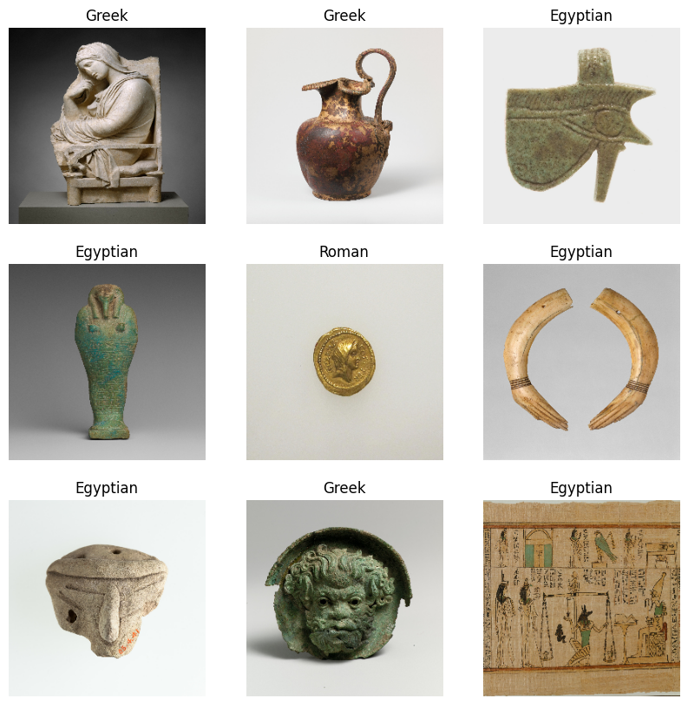
Data Processing
Image Augmentation Visualization
Image Data Snippet
Labeling
Generate a dataset with images
Put images into categories
Image Augmentation
Rotate, mirror images
Generate additional data to predict overfitting

Slide 10
Data Categorizations
The combination of categories we included:
1.original dataset | Egyptian | Near East | Greek | Roman
 | 300 | 150 | 250 | 50
2.offset Roman’s imbalance | Egyptian | Near East | Greek
 | 300 | 150 | 250
3.binary classification | Egyptian |  | Greek + Roman
 | 300 |  | 250 + 50 = 300
Notes:
hold for potential data processing/conclusion

Slide 11
03
Model
A Convolution Neural Network that takes in images and classify artworks into its cultures

Slide 12
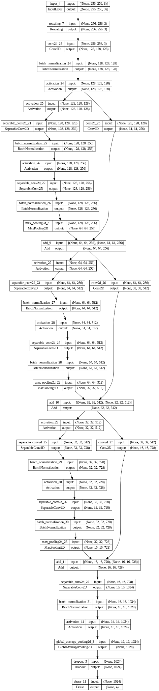
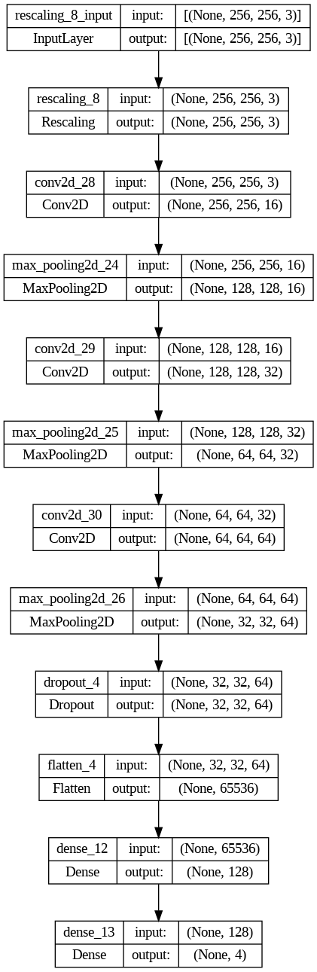
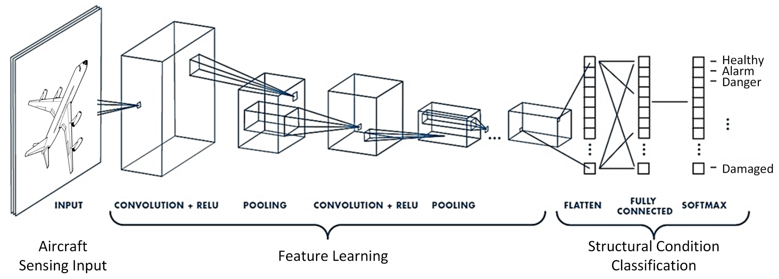
Model 1
Model 2
Our Model
Convolutional Neural Network (CNN)
Classic Image Classification models
Available library Tensorflow & Keras
Keras Model Prototype
hard to interpret
slow training
High Level Tensorflow model
very basic CNN

Slide 13
Model Performance
Model |  |  | Data | Accuracy
Model 2, epoch 10 |  |  | Wiki Art | 0.77
Model 1, epoch 15 |  |  | MET Collection | 0.64
Model 2, epoch 25 |  |  | MET Collection | 0.53
Model 2, epoch 25 |  |  | MET: Egyptian, Near East, Greek | 0.57
Model 2, epoch 25 |  |  | MET: Egyptian, Greek+Roman | 0.63

Slide 14
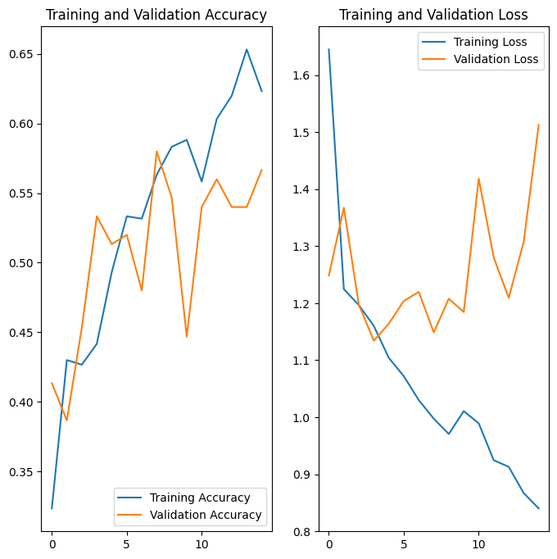
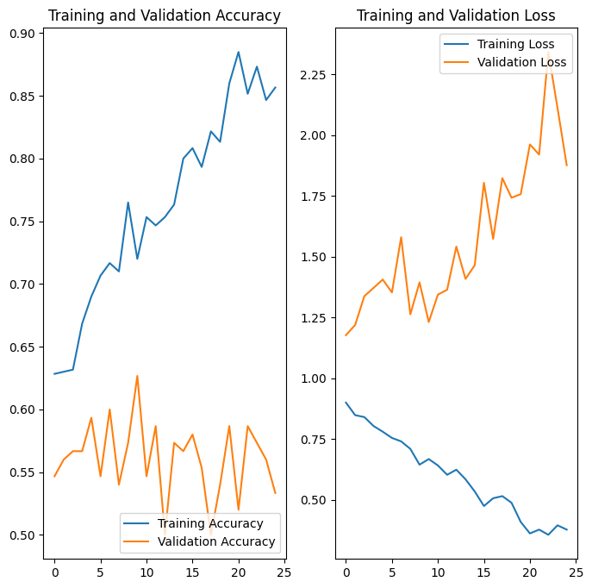
Model 1, epoch 15
Model 2, epoch 25
2 Models’ Training Visualization

Slide 15
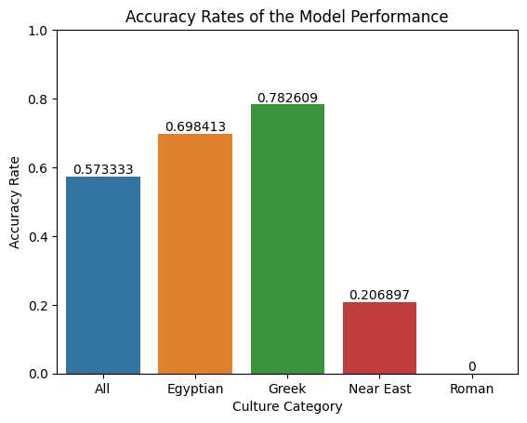
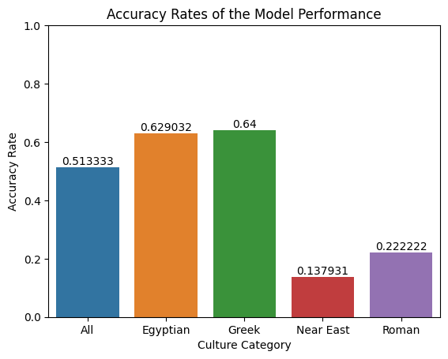
Model 1, epoch 15
Model 2, epoch 25
2 Models’ Accuracy Rates

Slide 16
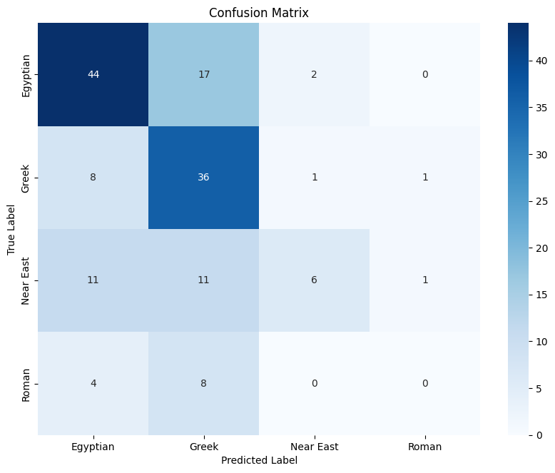
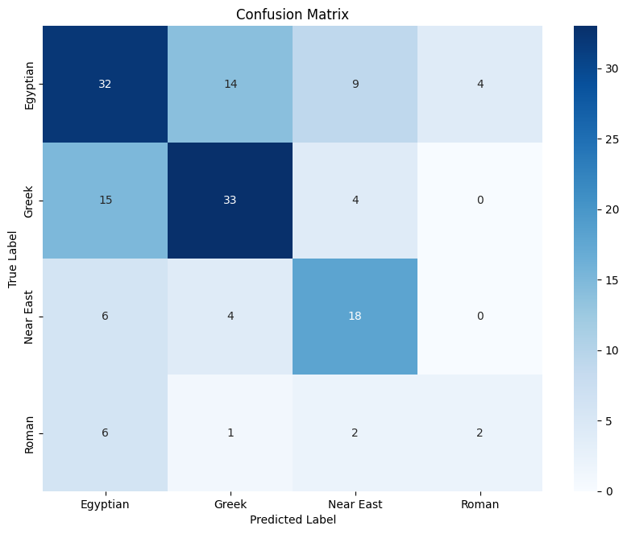
Model 1, epoch 15
Model 2, epoch 25
2 Models’ Confusion Matrix

Slide 17
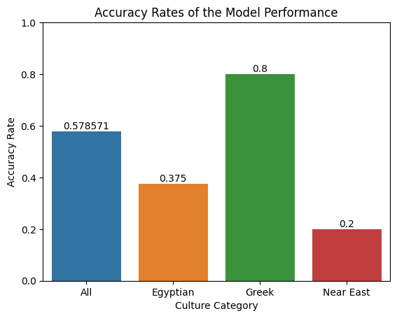
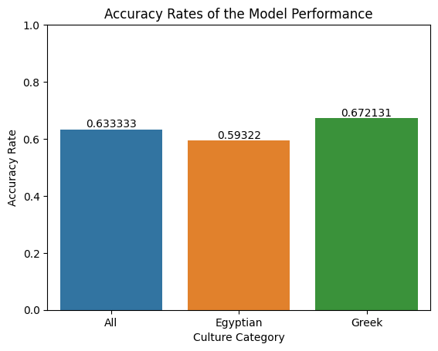
Original Dataset
Egyptian, Greek, Near East
Egyptian, Greek + Roman
3 Data Categorization Visualization

Slide 18
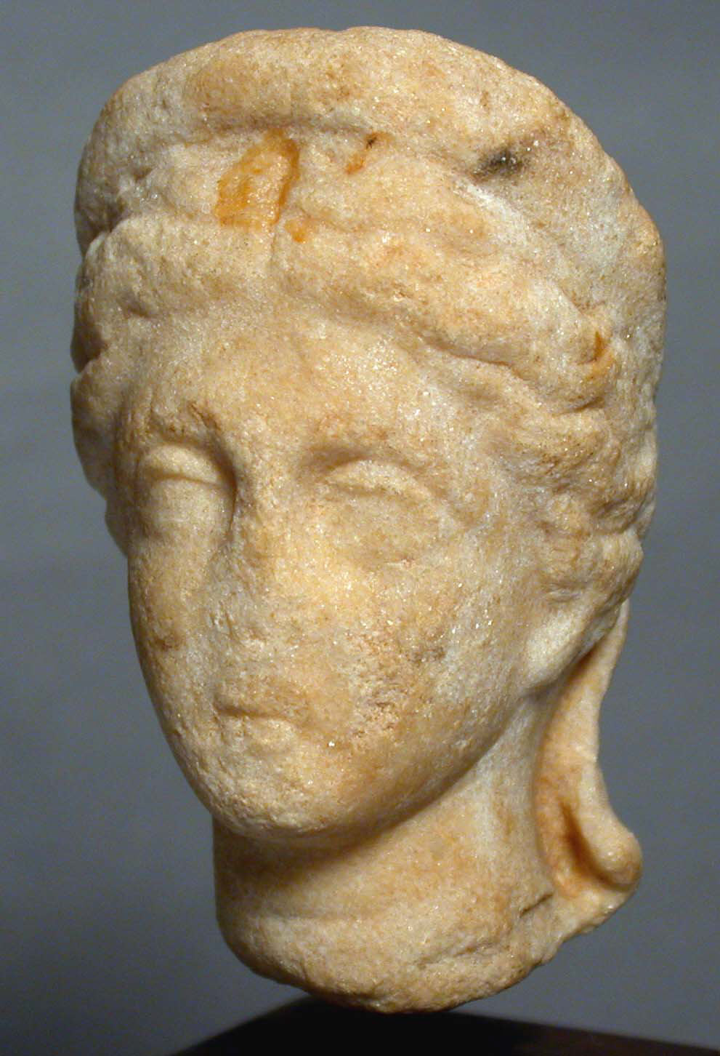
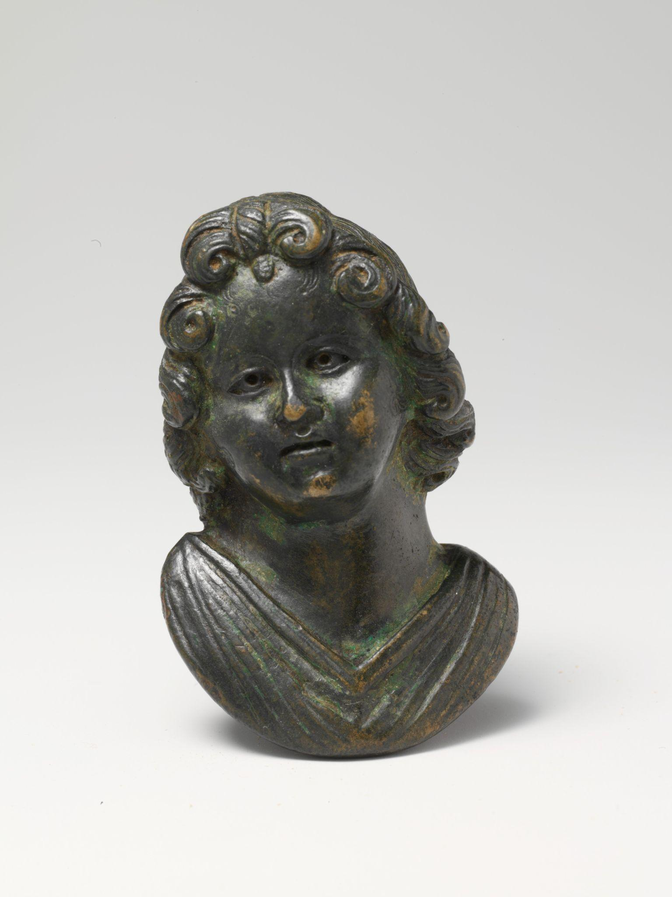
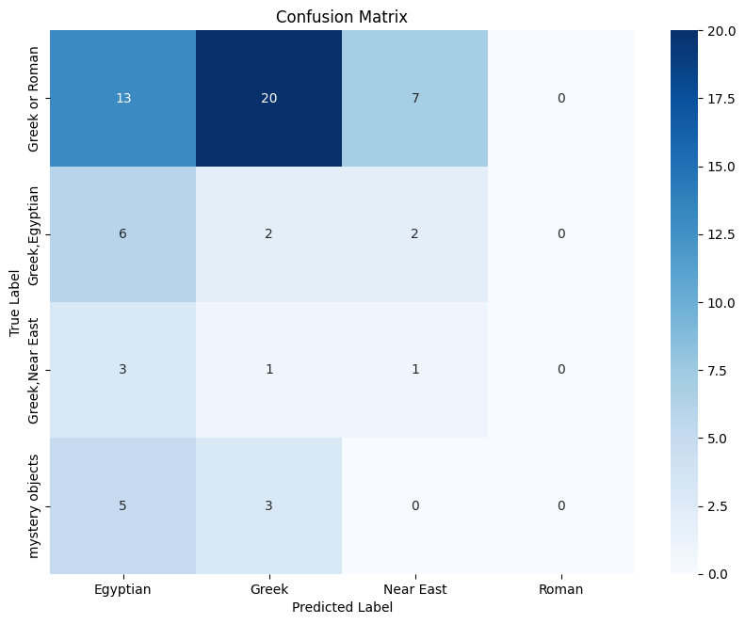
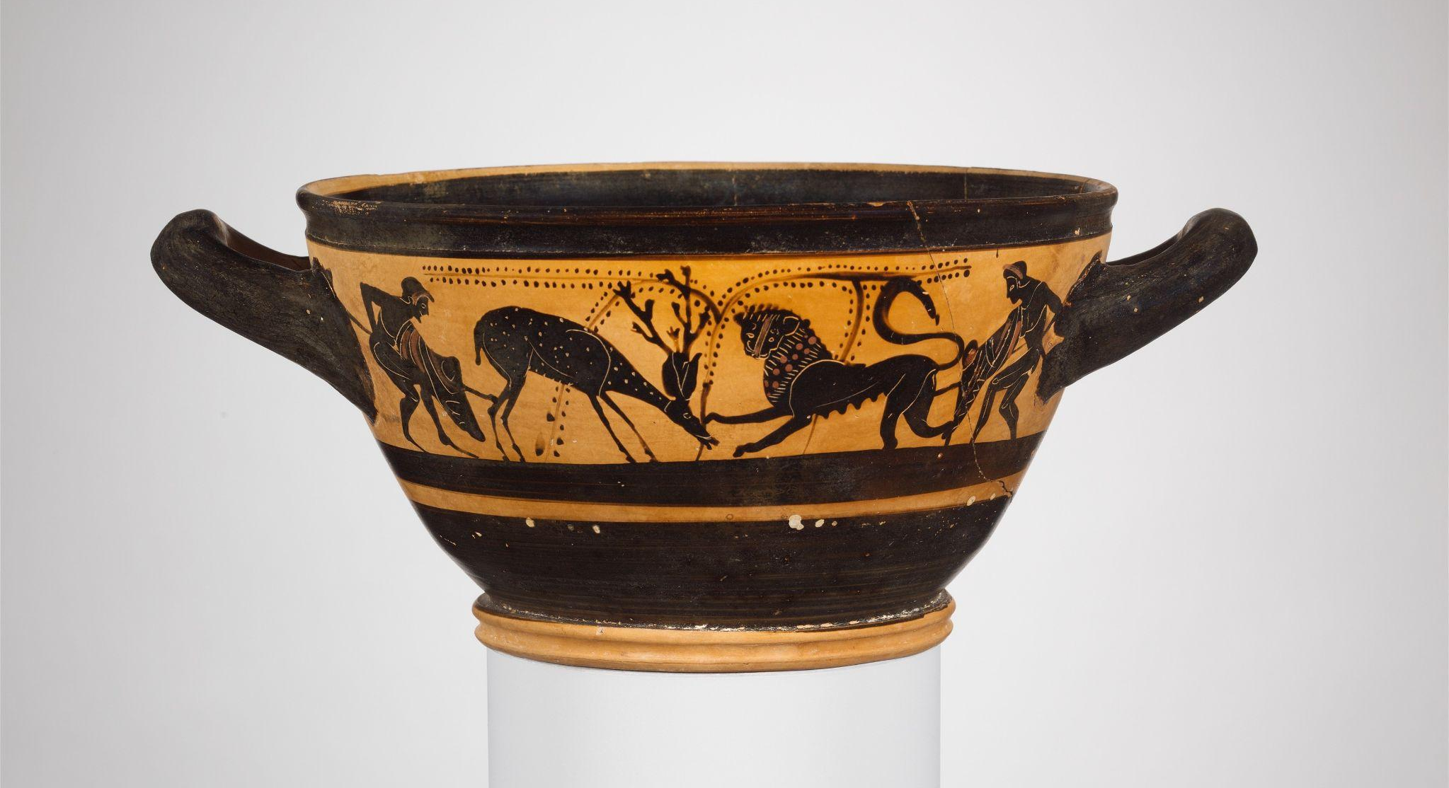
Greek/Egyptian
Greek/Roman
Greek/Near East
Confusion Matrix of Mystery objects & Prediction
Model Prediction on Mystery Object

Slide 19
Insights from the Model
Observations:
The model is best at distinguishing “Greek”
“Near East” yields good result though being a discrete collection
“Roman” is never predicted
Validation accuracy does not improve as much as the training accuracy
Model’s performance is not stable
Some Insights concluded from the results:
Model’s prediction is largely based on the distribution of data
Model has low confidence in the category with smallest dataset
Increasing epochs doesn’t improve the model’s performance significantly after 15 in this case
“Near East” is quite distinct from the others
“Greek” has very considerable similarity with “Egyptian” & “Roman”

Slide 20
04
Final Thoughts
The better the data,
the merrier the result

Slide 21
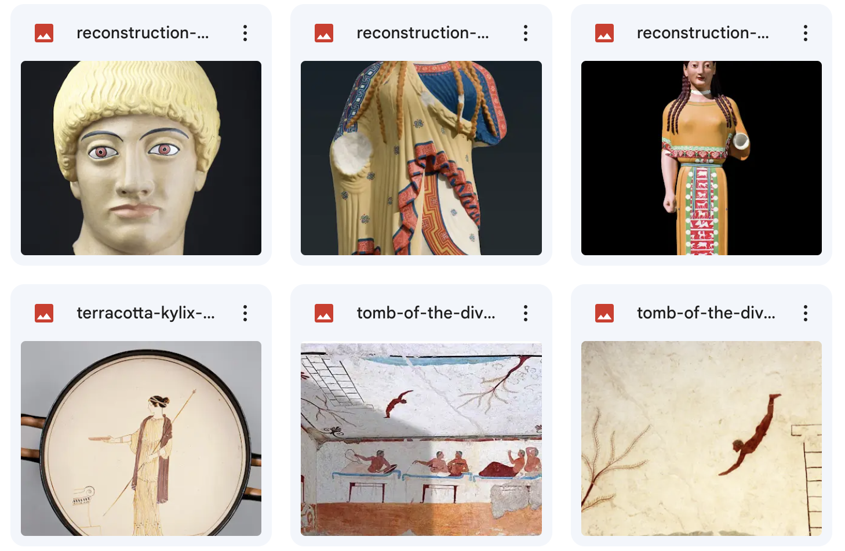
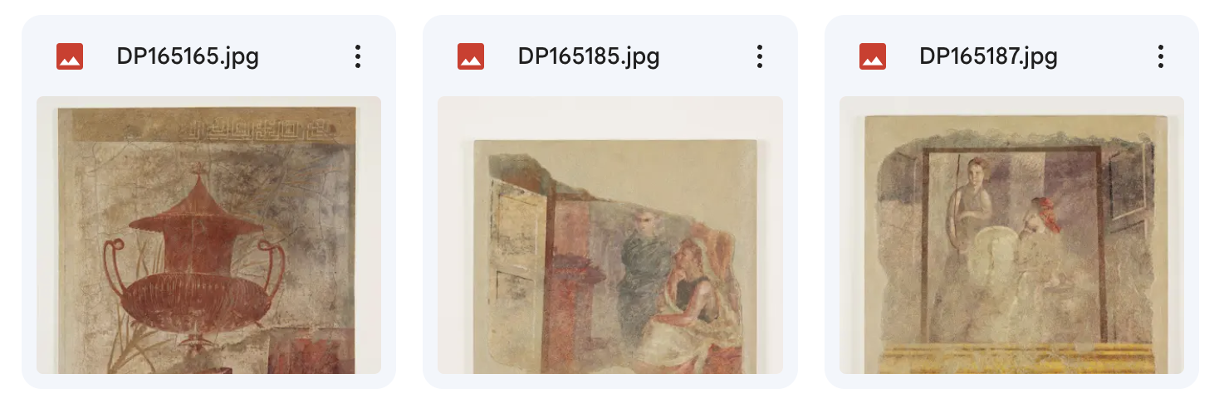
Data Collection Reflection
Prolonged data gathering phase
Explore artworks of ancient cities
Gain insights about the availability of works
Artwork from Ancient Cities
Limit Availability
Difficult to put into 1 category
High similarity/ influence between artworks
pattern
material
subject
Arbitrary choices
Imbalance distribution
Categories vary in the collection
Notes:
This project concludes my studying of art history of ancient cities and of machine learning in general. The project itself mimics real-world ML model training procedure. The prolonged data collection phase is unexpected, but through the manual image downloading I surprisingly went over a huge number of artworks in different cultures – including the ones we covered in class, the ones chosen by classmates as research subjects, and many more exciting new ones. The overall digging of data also provides insights about the number of artworks we have discovered in different cultures– Egypt being examined the most, and Roman being discovered the least, despite many discrete cultures that are categorized in the “Near East” category. The MET collection’s classification is also not as standardized– sometimes based on location like the ones in “Near East,” and sometimes very specified like the “New Kingdom”, “Late Period”, “Third Intermediate Period” in the Egyptian category. Moreover, the model training is highly dependent on the image data at this stage, since I am mostly applying a built package. The image data from different collections are difficult to be merged into one because of the different documenting style, and the limited availability and record also makes it hard to scientifically make sure the image data is clean and correct. If it were trained by the institution that owns the database, we could accordingly train more variations of the data– for example, only focusing on distinguishing Egyptian artworks, or categorizing the images in multiple ways. Lastly, image classification models are a kind of neural network, which is a more nuanced category within ML. Neural networks are very hard to interpret, so it requires huge effort to decipher the model to totally understand the model’s mechanism. Though this allows a powerful mode and space for art historical perspective to analyze, the information it can provide about its prediction is still limited so we can not completely rely on its prediction as a correct answer but as a guidance of further research.

Slide 22
Our Thoughts about the Model
Data Quality
Low Explanantility
The quantity & quality of the data largely affect the performance of the model.
The difficulty to decipher neural networks makes it hard for us to know exactly what features to change after the training of one model.
Costy Training
Lack of Experience
The model takes around 1~3 hours to train. The time & energy required makes it difficult for us to train as many iterations as we want for the ideal feature selection, hyperparameter tuning, etc.
The high flexibility of CNN offers many possibilities for the model tuning, but also adds difficulty for our design decisions. Instead of making proactive decisions, we can only observe the effect of changes after every training iteration.

Slide 23
Thank you!

Slide 24
Resources
DuBois, J. (n.d.). Using Conv Using Convolutional Neur olutional Neural Networks t al Networks to Classify Ar o Classify Art Genre . John Carroll University Carroll Collected. https://collected.jcu.edu/cgi/viewcontent.cgi?article=1147&context=honorspapers
Zoe Falomir, Lledó Museros, Ismael Sanz, Luis Gonzalez-Abril, Categorizing paintings in art styles based on qualitative color descriptors, quantitative global features and machine learning (QArt-Learn), Expert Systems with Applications, Volume 97, 2018, Pages 83-94, ISSN 0957-4174, https://doi.org/10.1016/j.eswa.2017.11.056.
Egypt, Samos, and the archaic style in greek sculpture - sage journals. (n.d.-b). https://journals.sagepub.com/doi/10.1177/030751338106700108

